Slide 1
Floating-Point: Rounding
Overflow: number too large to be represented
Underflow: number too small to be represented
Rounding modes:
Down
Up
Toward zero
To nearest
Example: round 1.100101 (1.578125) to only 3 fraction bits
Down: 1.100
Up: 1.101
Toward zero: 1.100
To nearest: 1.101 (1.625 is closer to 1.578125 than 1.5 is)

Slide 2
Floating-Point Addition
Extract exponent and fraction bits
Prepend leading 1 to form mantissa
Compare exponents
Shift smaller mantissa if necessary
Add mantissas
Normalize mantissa and adjust exponent if necessary
Round result
Assemble exponent and fraction back into floating-point format

Slide 3
Floating-Point Addition Example
Add the following floating-point numbers:
0x3FC00000 (1.5 = 1.5*2^0)
0x40500000 (3.25 = 1.625*2^1)

Slide 4
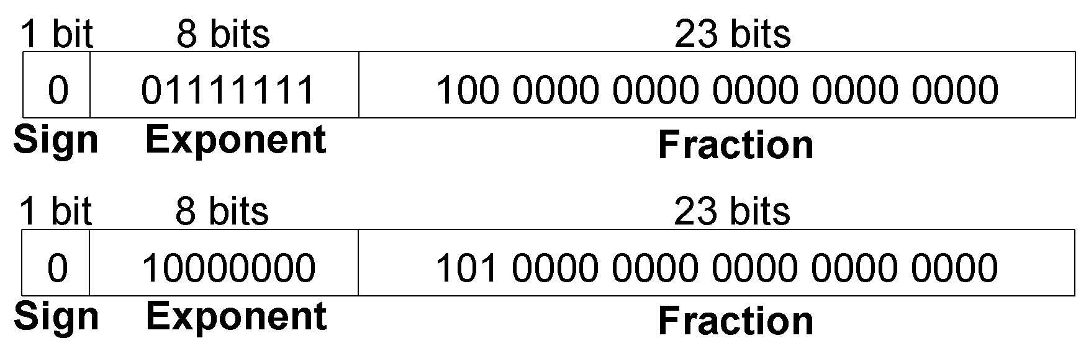
Floating-Point Addition Example
1. Extract exponent and fraction bits
For first number (N1): S = 0, E = 127, F = .1
For second number (N2): S = 0, E = 128, F = .101
2. Prepend leading 1 to form mantissa
N1: 1.1
N2: 1.101

Slide 5
Floating-Point Addition Example
3. Compare exponents
127 – 128 = -1, so shift N1 right by 1 bit
4. Shift smaller mantissa if necessary
shift N1’s mantissa: 1.1 >> 1 = 0.11 (× 2¹)
5. Add mantissas
0.11 × 2¹
+ 1.101 × 2¹
10.011 × 2¹

Slide 6
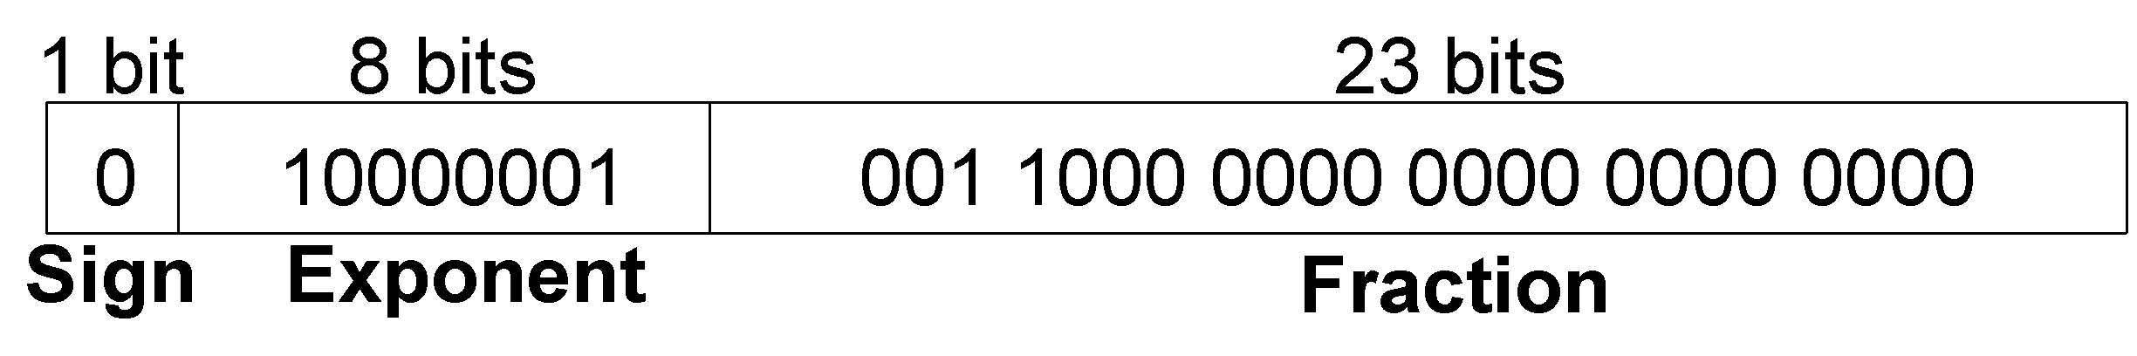
Floating-Point Addition Example
6. Normalize mantissa and adjust exponent if necessary
10.011 × 2¹ = 1.0011 × 2²
7. Round result
No need (fits in 23 bits)
8. Assemble exponent and fraction back into floating-point format
S = 0, E = 2 + 127 = 129 = 10000001₂, F = 001100..
in hexadecimal: 0x40980000

Slide 7
Moltiplicazione Floating-Point
Somma degli esponenti
Prodotto delle mantisse
Normalizzazione del risultato (se necessario)

Slide 8
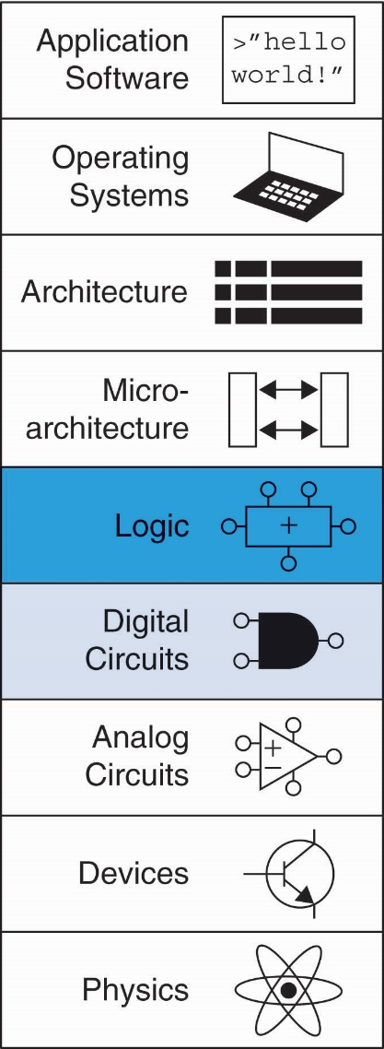
Chapter 2 :: Topics
Introduction
Logic Gates
Boolean Equations
Boolean Algebra
From Logic to Gates
Multilevel Combinational Logic
X’s and Z’s, Oh My
Karnaugh Maps
Combinational Building Blocks
Timing

Slide 9
Logic gates

Slide 10
Logic Gates
Perform logic functions:
inversion (NOT), AND, OR, NAND, NOR, etc.
Single-input:
NOT gate, buffer
Two-input:
AND, OR, XOR, NAND, NOR, XNOR
Multiple-input

Slide 11
Single-Input Logic Gates

Slide 12
Two-Input Logic Gates

Slide 13
More Two-Input Logic Gates

Slide 14
Multiple-Input Logic Gates
Multi-input XOR: Odd parity

Slide 15
Introduction
A logic circuit is composed of:
Inputs
Outputs
Functional specification
Timing specification

Slide 16
Circuits
Nodes
Inputs: A, B, C
Outputs: Y, Z
Internal: n1
Circuit elements
E1, E2, E3
Each a circuit

Slide 17
Types of Logic Circuits
Combinational Logic
Memoryless
Outputs determined by current values of inputs
Sequential Logic
Has memory
Outputs determined by previous and current values of inputs

Slide 18
Rules of Combinational Composition
Every element is combinational
Every node is either an input or connects to exactly one output
The circuit contains no cyclic paths
Example:

Slide 19
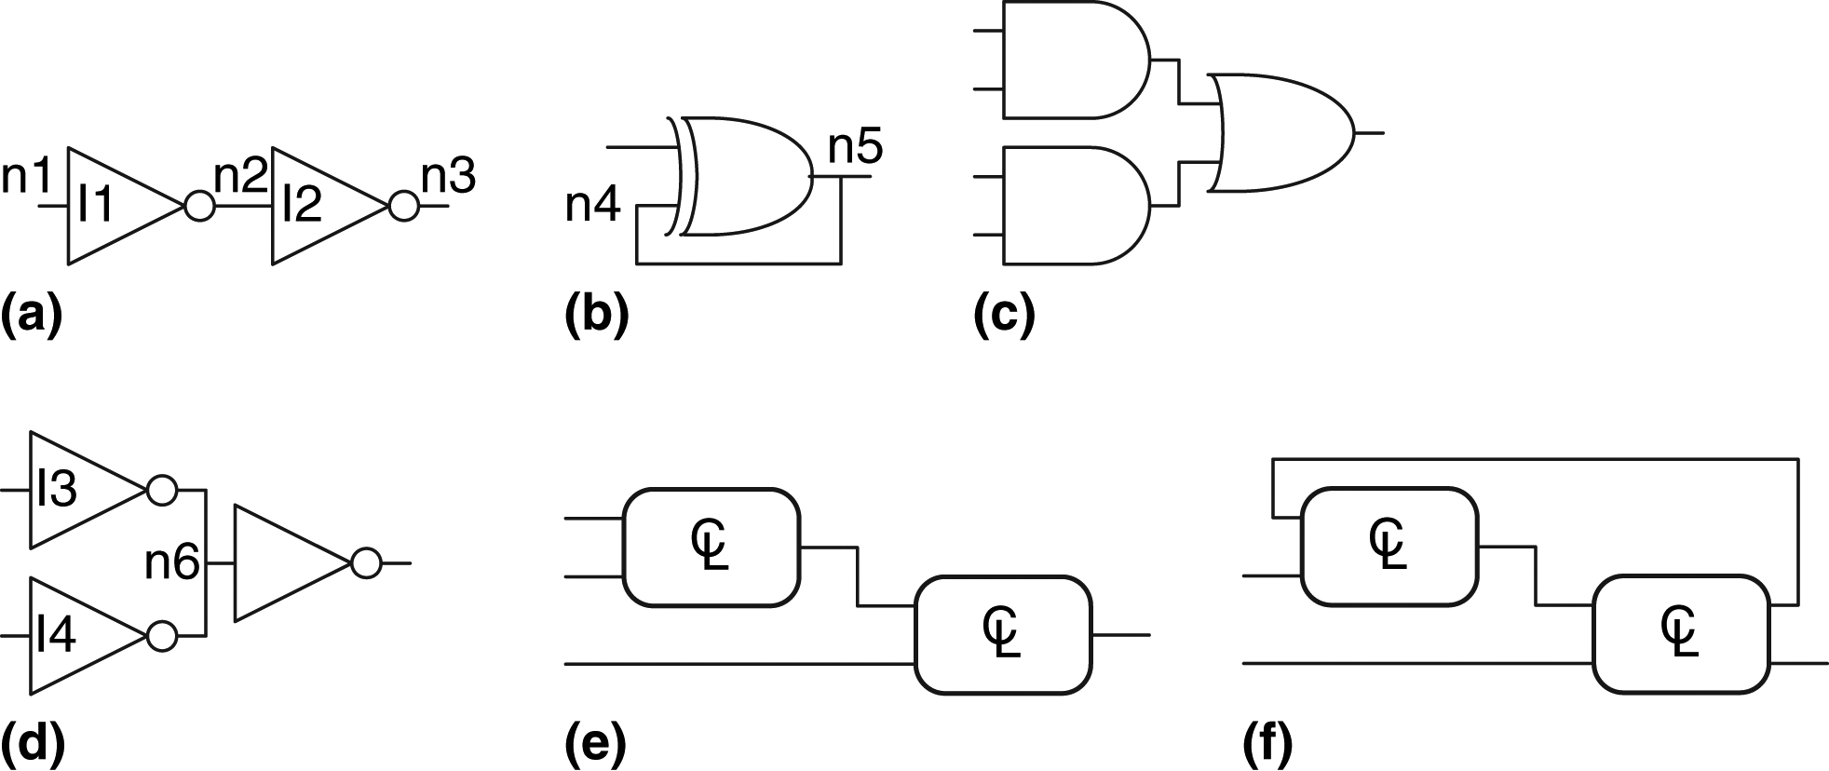
Figure 2.7 Example circuits
Check if they are combinational

Slide 20
Boolean Equations
Functional specification of outputs in terms of inputs
Example: S = F(A, B, C_{in})
C_{out} = F(A, B, C_{in})

Slide 21
Some Definitions
Complement: variable with a bar over it
A, B, C
Literal: variable or its complement
A, A, B, B, C, C
Implicant: product of literals
ABC, AC, BC
Minterm: product that includes all input variables
ABC, ABC, ABC
Maxterm: sum that includes all input variables
(A+B+C), (A+B+C), (A+B+C)

Slide 22
Sum-of-Products (SOP) Form
All equations can be written in SOP form
Each row has a minterm
Y = F(A, B) =

Slide 23
Sum-of-Products (SOP) Form
All equations can be written in SOP form
Each row has a minterm
A minterm is a product (AND) of literals
Each minterm is TRUE for that row (and only that row)
Y = F(A, B) =

Slide 24
Sum-of-Products (SOP) Form
All equations can be written in SOP form
Each row has a minterm
A minterm is a product (AND) of literals
Each minterm is TRUE for that row (and only that row)
Form function by ORing minterms where output is 1
Thus, a sum (OR) of products (AND terms)
Y = F(A, B) =

Slide 25
Sum-of-Products Form
Sum-of-Products (SOP) Form
All equations can be written in SOP form
Each row has a minterm
A minterm is a product (AND) of literals
Each minterm is TRUE for that row (and only that row)
Form function by ORing minterms where output is 1
Thus, a sum (OR) of products (AND terms)
Y = F(A, B) =

Slide 26
Sum-of-Products Form
Sum-of-Products (SOP) Form
All equations can be written in SOP form
Each row has a minterm
A minterm is a product (AND) of literals
Each minterm is TRUE for that row (and only that row)
Form function by ORing minterms where output is 1
Thus, a sum (OR) of products (AND terms)
Y = F(A, B) = AB + AB = Σ(1, 3)

Slide 27
Fine lezione
Per la prossima lezione:
Fare esercizi PSD3-esercizi
Studiare capitolo 2 fino a 2.4

